Slide 1

SOC
OPEN-SOURCE SECURITY OPERATIONS LAB
Automated Threat Detection
& Response
Wazuh SIEM · Shuffle SOAR · Tailscale Mesh
A 5-person distributed SOC & SOAR home lab — built, attacked,
detected, and auto-contained end to end.
ACADEMIC / PORTFOLIO PROJECT
Notes:
1

Slide 2
OVERVIEW
Presentation flow
01
Setup
Wazuh manager · agents · Shuffle · Tailscale mesh
02
Attacks
SSH brute force · suspicious PowerShell · command & control
03
Detection
Live evidence captured in the Wazuh dashboard
04
Response
Automated containment through the SOAR pipeline
WAZUH + SHUFFLE SOC LAB
01
Notes:
2

Slide 3
SETUP
Lab architecture
A private Tailscale mesh connects five contributors across five separate locations — every node reachable on 100.x addressing.
ATTACKER MACHINES · OUTSIDE TAILNET (LOCAL ONLY)
Kali attacker
Windows attacker
Windows attacker
SSH brute force
PowerShell payload
Command & control
TAILSCALE TAILNET
Ubuntu victim
Windows victim
Windows Server
SSH brute force
Suspicious PowerShell
Command & control
Wazuh Manager — SIEM
Collects agent logs · correlates · fires alerts
Shuffle — SOAR
Webhook intake · enrichment · automated response
WAZUH + SHUFFLE SOC LAB
02

Slide 4
SETUP
Five contributors, five roles
MS
OK
MM
K
MB
Mohamed Sabry
Omar Khaled
Mohamed Massoud
Karim
Mohamed Bushnak
Wazuh SIEM
Shuffle SOAR
SSH target
PowerShell target
C2 target
Manager deployment & detection rules
Automation, enrichment & response
Ubuntu victim — brute force scenario
Windows victim — malicious script exec
Windows Server — command & control
WAZUH + SHUFFLE SOC LAB
03
Notes:
4

Slide 5
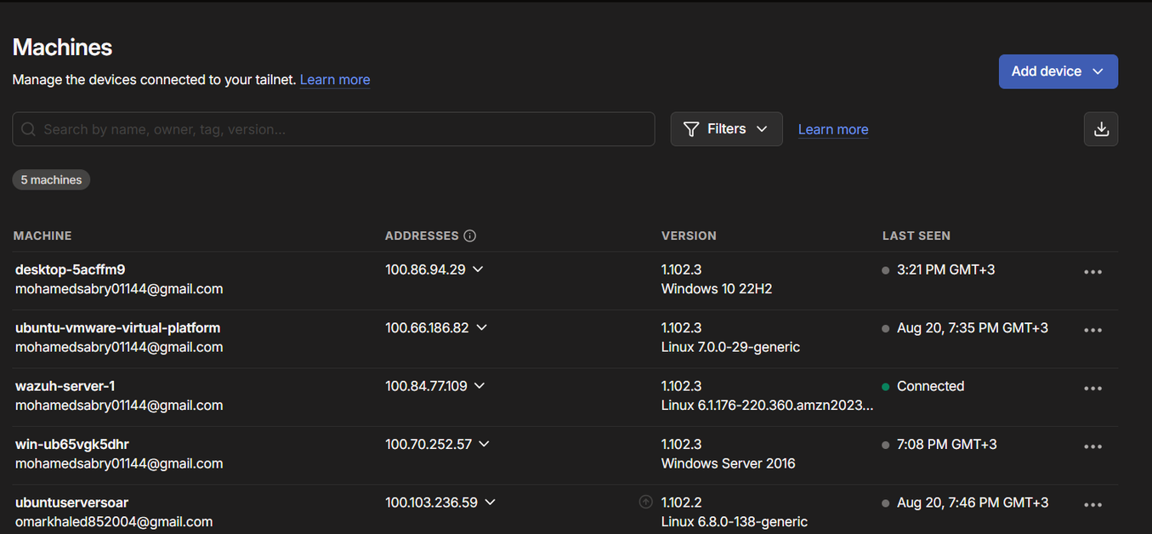
SETUP
Tailscale mesh connectivity
Five machines, five networks, one private tailnet — every node reachable on a flat 100.x address space.
Only endpoints join
Victim VMs, the manager, and Shuffle — attacker VMs stay fully local.
Owner-approved
Every new device is manually approved before it can reach the mesh.
Location-independent
Five contributors, five networks, one flat 100.x address space.
All 5 lab machines online in the tailnet
WAZUH + SHUFFLE SOC LAB
04
Notes:
5

Slide 6
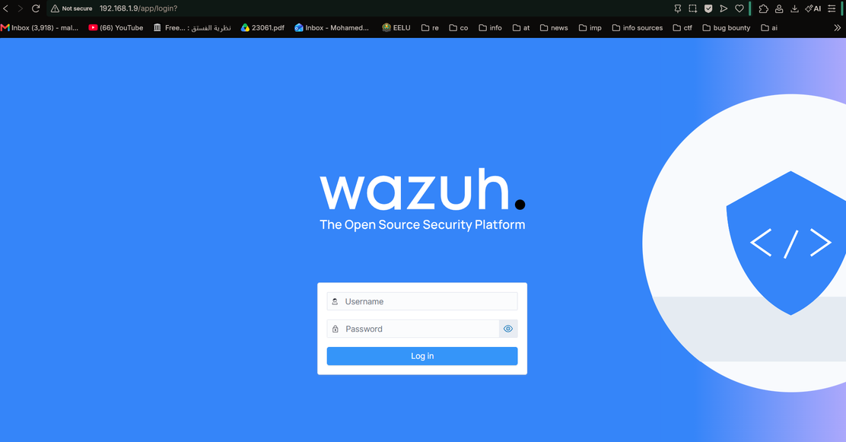
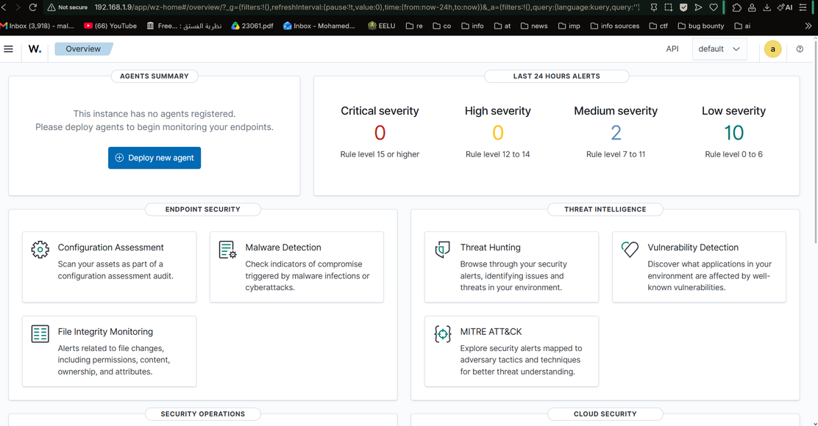
SETUP
Wazuh manager deployment
Deployed from the official all-in-one OVA (v4.14) in VirtualBox, then hardened before joining the tailnet.
Dashboard login
Operational overview — agent & alert summary
✓
OVA v4.14 imported in VirtualBox
✓
Default credentials rotated on first boot
✓
Joined to a private, admin-owned Tailscale tailnet
WAZUH + SHUFFLE SOC LAB
09
Notes:
10

Slide 7
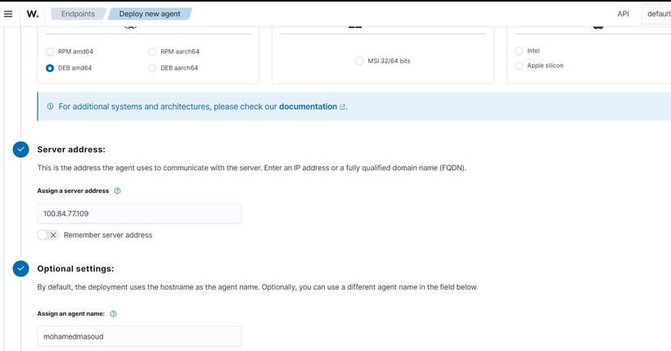
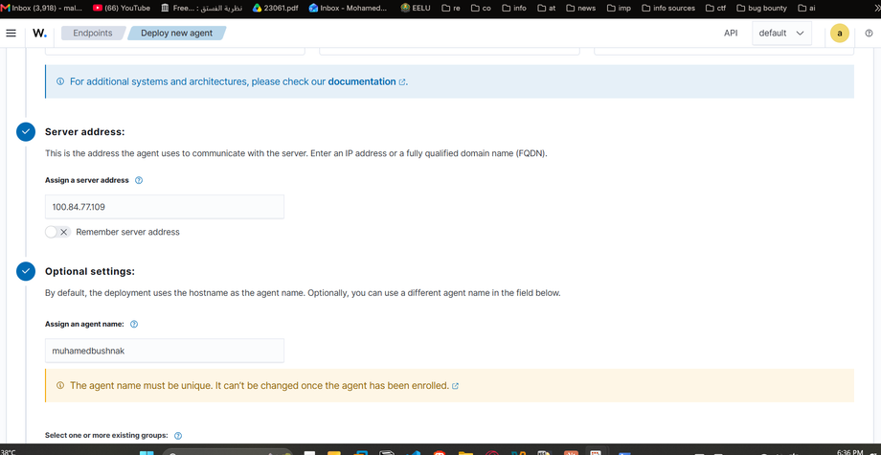
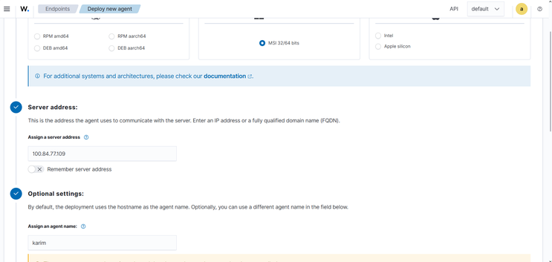
SETUP
Deploying the Wazuh agents
Each victim machine installs the Wazuh agent and enrolls against the manager's Tailscale address before any attack runs.
Agent configuration — manager address set
Windows victim — first agent enrollment
Windows Server — agent install
mohamedmassoud
karim
muhamedbushnak
Ubuntu
Windows
Windows Server
SSH brute-force target
PowerShell target
C2 target
WAZUH + SHUFFLE SOC LAB
10
Notes:
11

Slide 8
ATTACKS
Three attack scenarios
01
02
03
Command & Control
Suspicious PowerShell
SSH Brute Force
Windows Server
Windows
Ubuntu
PsExec-style remote execution attempt against the Windows Server host.
ExecutionPolicy bypass with an IEX / DownloadString cradle pulling a remote payload.
Nmap recon followed by a Hydra credential-stuffing run against the Ubuntu victim's SSH service.
WAZUH + SHUFFLE SOC LAB
05
Notes:
6

Slide 9
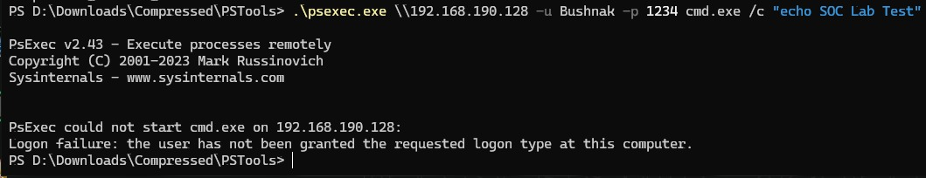
ATTACKS
Attack execution — command & control
Mohamed Bushnak — PsExec-style remote command attempt against the Windows Server host.
PsExec attempt — logged against the Windows Server target
Target
Technique
Outcome
muhamedbushnak — Windows Server
Remote service execution (PsExec-style)
Logon-type failure recorded and correlated in Wazuh
WAZUH + SHUFFLE SOC LAB
06
Notes:
7

Slide 10
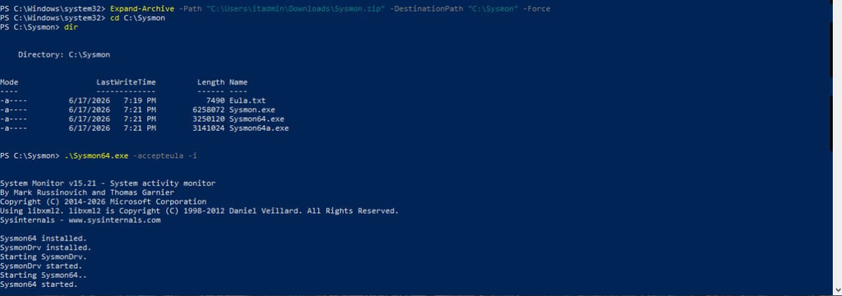
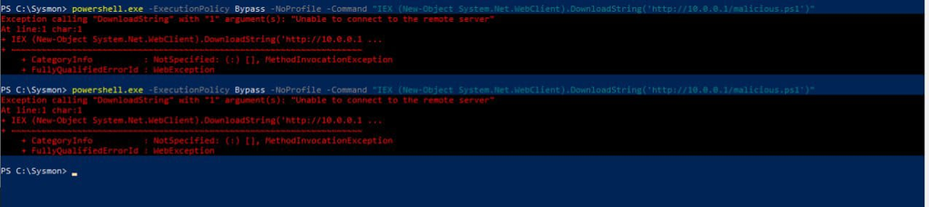
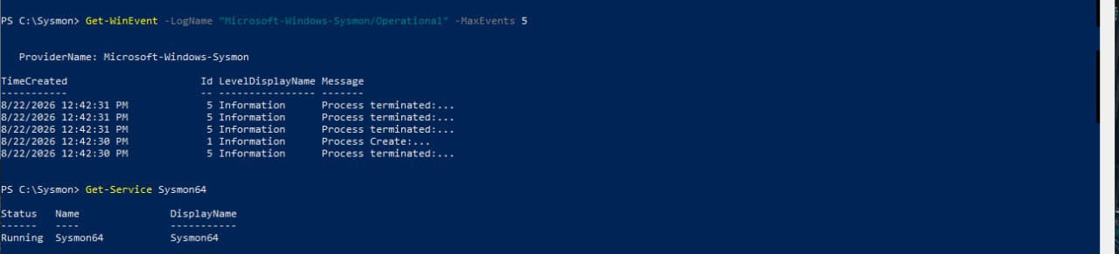
ATTACKS
Attack execution — suspicious PowerShell
Karim — ExecutionPolicy bypass with an IEX / DownloadString download cradle against the Windows victim.
Download cradle triggering the payload fetch
PowerShell execution — bypass flag set
Full command line captured for the script block
WAZUH + SHUFFLE SOC LAB
07
Notes:
8

Slide 11
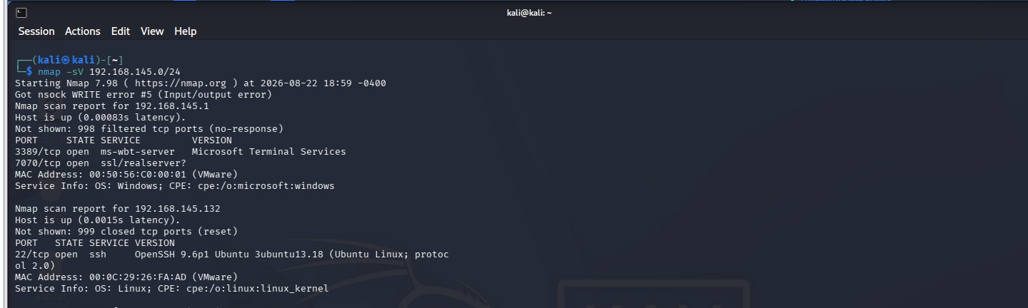
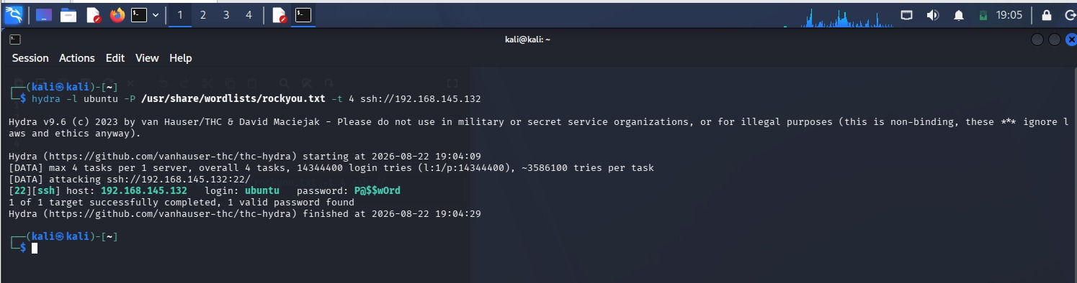
ATTACKS
Attack execution — SSH brute force
Mohamed Massoud — Nmap reconnaissance followed by Hydra against the Ubuntu victim's SSH service.
Nmap scan — open SSH service identified on the Ubuntu target
Hydra — valid credential recovered
WAZUH + SHUFFLE SOC LAB
08
Notes:
9

Slide 12
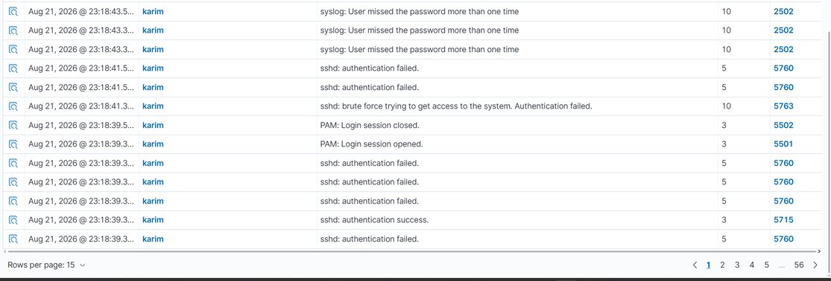
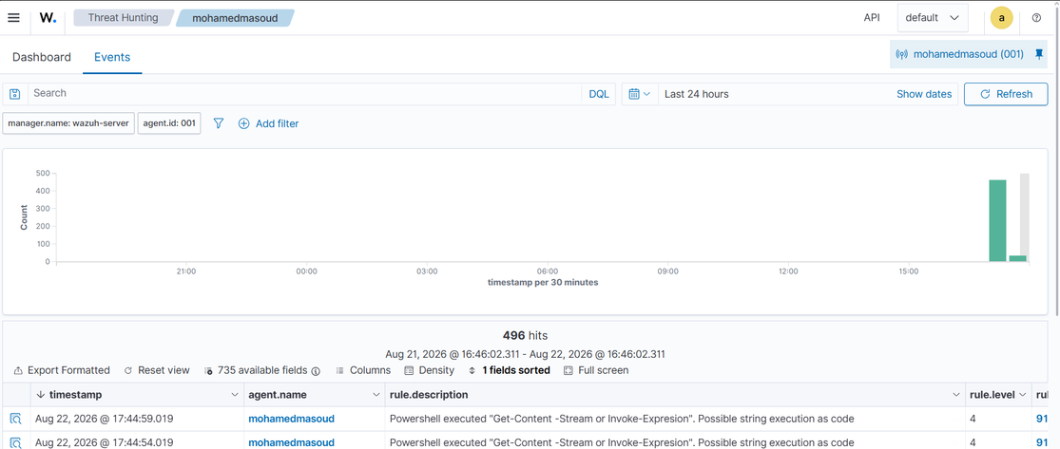
EVENTS
Detection — all three scenarios in Wazuh
Every attack technique was correlated into a rule match and surfaced live in the dashboard.
SSH brute force — rules 5710 · 5712 · 5763
Suspicious PowerShell — EncodedCommand / IEX pattern
C2 — rule 92650, level 12 — New Windows Service Created (muhamedbushnak)
WAZUH + SHUFFLE SOC LAB
11
Notes:
12

Slide 13
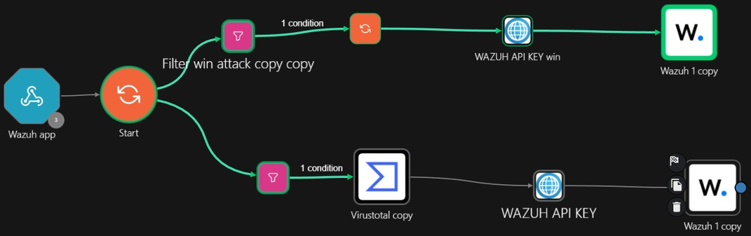
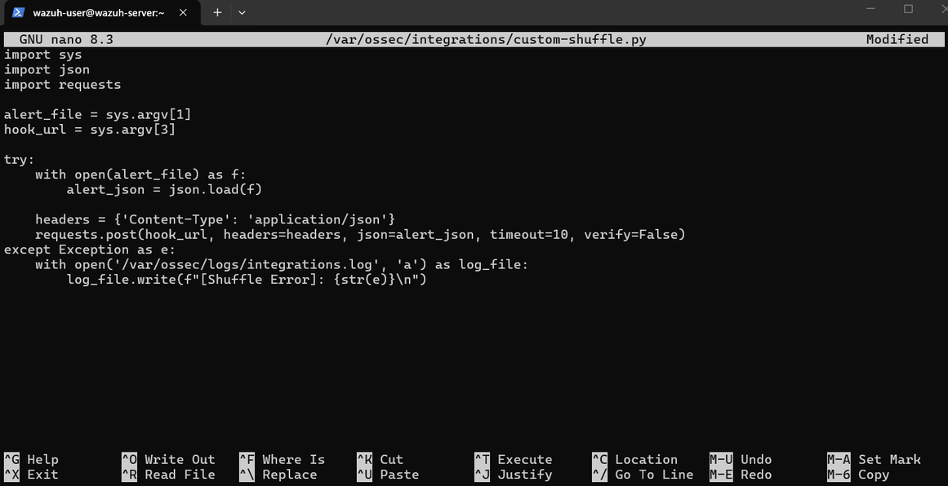
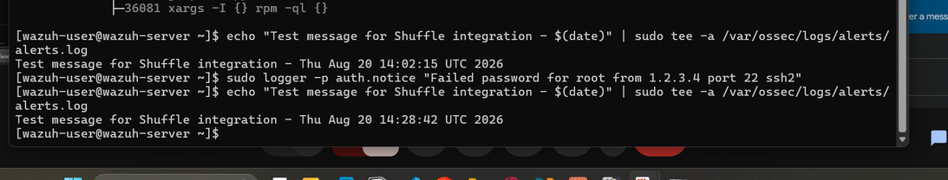
RESPONSE
Alert path: Wazuh → Shuffle
Every qualifying rule match is posted as JSON to Shuffle's webhook, parsed, and routed through an automated workflow.
Alert
→
Webhook
→
Workflow
→
Action
Rule match
JSON · Tailscale
Shuffle
AR / notify
Shuffle workflow — branching by rule, VirusTotal enrichment, dual Wazuh actions
Integration test — alert delivered successfully
ossec.conf — Shuffle integration block
WAZUH + SHUFFLE SOC LAB
12
Notes:
13

Slide 14
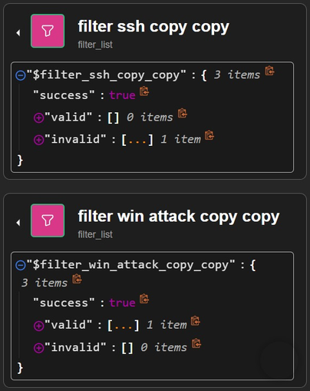
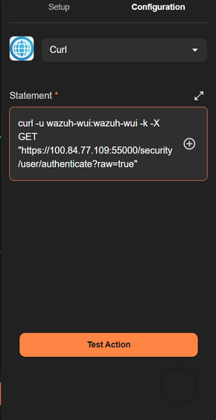
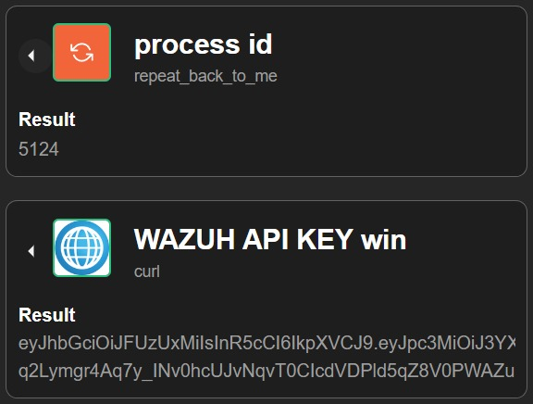
RESPONSE
Shuffle playbook — branching & automated actions
Rule ID drives the branch: SSH / RDP findings call the Wazuh active-response API directly through an authenticated session; other findings route through VirusTotal enrichment first.
Branch filters — SSH vs. Windows
Wazuh API auth (curl)
Process ID + JWT result
Both branches converge back on Wazuh — either firing active-response directly, or after a VirusTotal enrichment step — keeping every action auditable end to end.
WAZUH + SHUFFLE SOC LAB
13
Notes:
14

Slide 15
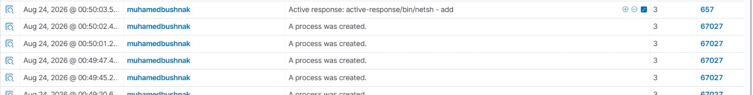
RESPONSE
Active response — command & control contained
Agent muhamedbushnak · rule 67027 (suspicious process creation) escalates to rule 657 — active-response/bin/netsh blocks the malicious service.
Wazuh alert log — netsh active-response fired on the Windows Server host
1
Process created
2
AR triggers
3
Service blocked
Suspicious service process detected — rule 67027, repeated
active-response/bin/netsh runs — rule 657
Malicious service contained on the Windows Server host
WAZUH + SHUFFLE SOC LAB
14
Notes:
15

Slide 16
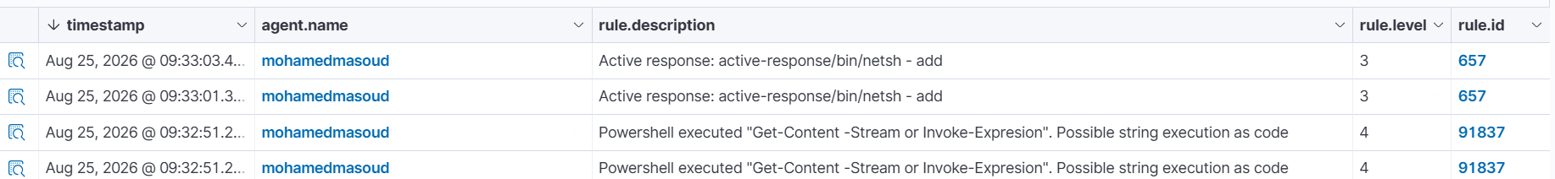
RESPONSE
Active response — suspicious PowerShell contained
Agent mohamedmasoud · rule 91837 (suspicious PowerShell string execution) escalates to rule 657 — active-response/bin/netsh blocks the host.
Wazuh alert log — netsh active-response fired after repeated PowerShell detections
1
Suspicious script
2
AR triggers
3
Host blocked
Get-Content -Stream / Invoke-Expression detected — rule 91837, repeated
active-response/bin/netsh runs — rule 657
Network access contained on the affected endpoint
WAZUH + SHUFFLE SOC LAB
15
Notes:
16

Slide 17
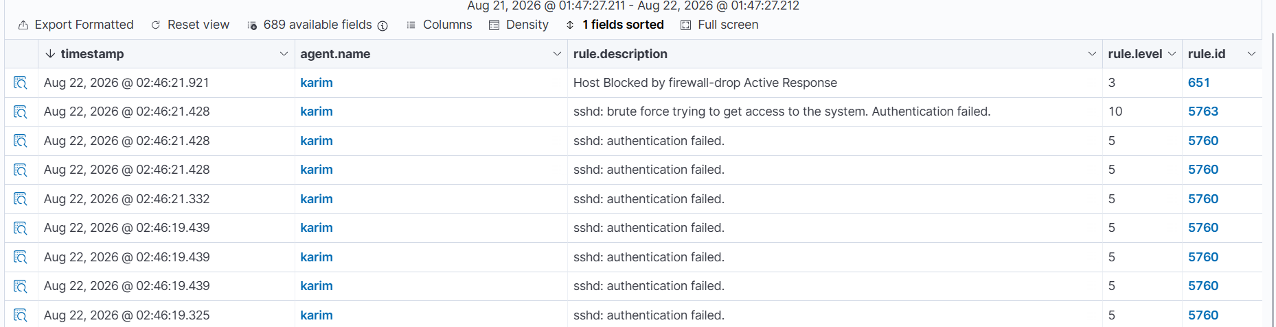
RESPONSE
Active response — SSH brute force blocked
Agent karim · rule 5763 (brute force) escalates to rule 651 — host blocked automatically by firewall-drop.
Wazuh alert log — active response fired against the source IP
1
Rule fires
2
AR triggers
3
IP blocked
SSH brute force detected — high severity
firewall-drop active-response command runs
Attacker IP dropped on the victim host
All three attack paths now have a proven detection-to-containment loop: C2 → netsh, PowerShell → netsh, SSH → firewall-drop.
WAZUH + SHUFFLE SOC LAB
16
Notes:
17

Slide 18
SUMMARY
What the lab delivers
Wazuh all-in-one SIEM live (OVA 4.14) on a private Tailscale mesh
Three victim endpoints enrolled and reporting across two OS families
✓
✓
SSH brute-force attack executed and detected in real time
Suspicious PowerShell execution captured and correlated
✓
✓
Command & control attempt logged against the Windows Server target
Shuffle SOAR deployed on Docker, wired to Wazuh via webhook
✓
✓
Active response (firewall-drop) auto-blocking demonstrated end to end
A repeatable, fully open-source detection-to-response pipeline
✓
✓
WAZUH + SHUFFLE SOC LAB
17
Notes:
18

Slide 19
Setup → Attack → Detect → Respond
A complete open-source SOC path, proven with live evidence.
Thank you — questions welcome
WAZUH + SHUFFLE SOC LAB
18
Notes:
19

